Slide 1

Introduction to Unit Testing

Slide 2
Introduction to Unit Testing
Unit testing involves testing individual components of software, such as functions or classes, in isolation to ensure they function as intended.
It helps verify that each unit of code works correctly before integration with other parts of the system.
Importance:
Catches bugs early, reducing debugging time and costs.
Improves code quality and reliability.
Acts as documentation, showing expected behavior.
Supports modular design, easing refactoring and maintenance.
Benefits:
Early detection of defects.
Simplified debugging process.
Enhanced confidence in code changes.
Facilitates continuous integration.

Slide 3
Unit Testing in Python
Frameworks:
unittest: Built into Python’s standard library since version 2.1, inspired by JUnit. Ideal for structured, object-oriented testing.
pytest: A third-party framework with simpler syntax and powerful features, but requires installation.
This tutorial uses unittest for its accessibility and widespread use in Python projects.
Key Concepts:
Test Fixture: Setup and cleanup for tests (e.g., creating temporary files or databases).
Test Case: A single test checking a specific behavior, created by subclassing unittest.TestCase.
Test Suite: A collection of test cases or suites for organized execution.
Test Runner: Executes tests and reports results (e.g., pass, fail, or error).
Running Tests: Use python -m unittest or include unittest.main() in test scripts.

Slide 4
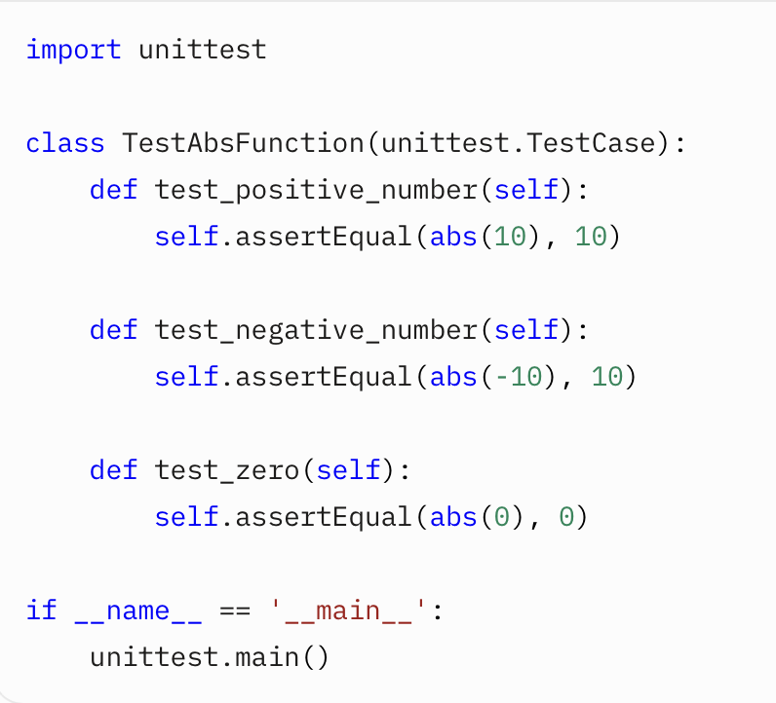
Basic Example - Testing the abs() Function
Test Python’s built-in abs() function to ensure it returns the absolute value of a number.
Explanation:
The TestAbsFunction class inherits from unittest.TestCase.
Three test methods check abs() for positive, negative, and zero inputs.
assertEqual verifies that the function’s output matches the expected result.

Slide 5
Assertion Methods in unittest
The unittest.TestCase class provides a variety of assertion methods to verify the behavior of your code.
These methods allow you to check if the expected output matches the actual output, among other conditions.
All assertion methods can take an optional msg parameter, which is used as the error message if the assertion fails.
Below is a comprehensive list of assertion methods available in Python’s unittest framework.
Method | Checks That
assertEqual(a, b, msg=None) | a == b
assertTrue(x, msg=None) | bool(x) is True
assertIs(a, b, msg=None) | a is b
assertIsNone(x, msg=None) | x is None
assertIn(a, b, msg=None) | a in b
assertGreater(a, b, msg=None) | a > b
assertListEqual(a, b, msg=None) | Lists a and b are equal

Slide 6
Commonly Used unittest Methods Besides Assertions
In addition to assertion methods, unittest provides several non-assertion methods and decorators that are essential for managing test environments, organizing tests, and ensuring test isolation. Below is a detailed list of commonly used methods, with examples to illustrate their practical application.
Setup and Teardown Methods
Method | Checks That
setUp() | Called before each test method to set up the test fixture (e.g., initializing objects or data). Ensures each test starts with a clean environment.
tearDown() | Called after each test method to clean up resources (e.g., deleting temporary files or closing connections).
setUpClass() | A class method called once before all test methods in the class. Used for setting up shared resources (e.g., a database connection).
tearDownClass() | A class method called once after all test methods in the class. Used for cleaning up shared resources.
setUpModule() | A module-level function run before all test cases in the module
tearDownModule() | A module-level function run after all test cases in the module.

Slide 7
Best Practices for Unit Testing
Write Tests First (Test-Driven Development - TDD): Define tests before coding to clarify requirements.
Keep Tests Independent: Ensure tests don’t rely on each other to avoid cascading failures.
Use Mocking for Dependencies: Mock external resources (e.g., databases, APIs) to isolate units.
Test Edge Cases: Cover boundary values, invalid inputs, and error conditions.
Automate Testing: Integrate tests into CI/CD pipelines for continuous validation.
Use Descriptive Test Names: Name tests clearly (e.g., test_negative_age) to indicate purpose.

Slide 8
References
Official Python Documentation: unittest — Unit testing framework
Real Python: Python's unittest: Writing Unit Tests for Your Code
GeeksforGeeks: Unit Testing in Python using unittest Framework
FreeCodeCamp: How to Write Unit Tests in Python
LambdaTest: Unit Testing in Python: Comprehensive Guide

Slide 9
Any questions?

